Slide 1
Session 3 – Using WRDS Data Data Skills for Research Kellogg Research Support
July 9, 2024
Notes:
WRDS is useful
Where to find info you want
Beware of info you don’t want (their connection information isn’t good) – it doesn’t allow for replication, etc).
Here is our recommendation

Slide 2
Replication Principles
Automate
Keep Good Records
Abstraction (modular workflows)
Test
Many journals now require you to specify data provenance details
(date downloaded, by whom, etc.)

Slide 3

WRDS Data Workflow
Never overwrite!
Extract | Collect Raw Data
Prep Data
for Analysis
Analyze
Data
Logging and testing via programs (version controlled)
Source data files can change!
Replicator might have different license rights
Notes:
This should be obvious to everyone. You should always document your code, and more comments and read-me files is bound to make things easier for your future self. Right?
<pause for effect>
<CLICK>
Actually, NO! I maintain that less is more when it comes to documentation.
In any event, you ABSOLUTELY MUST maintain your documentation. So if you have got comments running throughout your code, that’s fine,
but you will need to update the comments each time you update the code. Otherwise, you run the risk of your code doing one thing and your comments saying another.
That is a sure fire recipe for confusion when you crack open your Python program for the first time in 24 months to figure out why the numbers are suddenly different.

Slide 4
How WRDS Recommends You Connect
Method | Remarks
Web query form | Simple to find and use...
Interactive Dev Environs (Jupyter notebook, SAS Studio, ...) | Can run code and give you visual feedback...
WRDS Cloud | Can run batch processes in a queue...
but not automated or self-documenting
but requires mouse work and your attention
but with very limited storage!
Better way: Make a remote connection to WRDS databases from KLC!

Slide 5
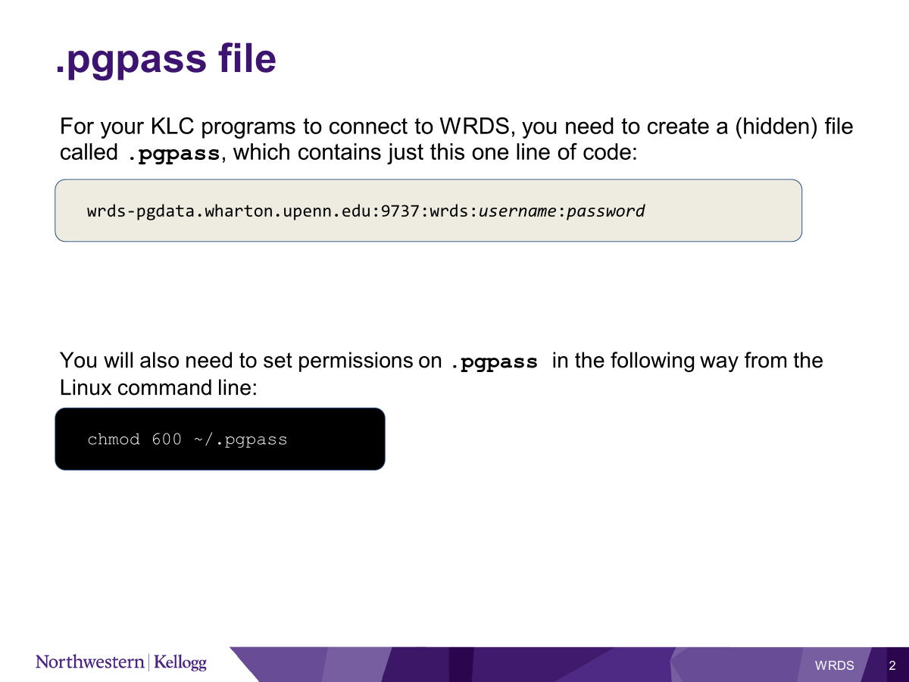

KLC – How You Should Connect
80 GB home directory, 2 TB+ project space
versus 10 GB home, 500 GB scratch at WRDS
All Quest scientific software and versions
plus conda, git, cron
Easy collaboration with Northwestern people
including Research Support

Slide 6
Demonstration

Slide 7
Some takeaways
Web interface, SAS Studio good for exploring, but not for research work
Use KLC to gather, store, process the data you need
Keep snapshots of raw data
Gather large data pulls in modular chunks
DO NOT EVER OVERWRITE RAW DATA
You can ask us for help

